Slide 1
31 Colóquio da AICL, Belmonte, Portugal, 12 – 15.04.2019
Anna Kalewska (U. Varsóvia)
Jan Karski contra o Holocausto.
História do herói polaco que tentou travar massacre de judeus na Europa

Slide 2
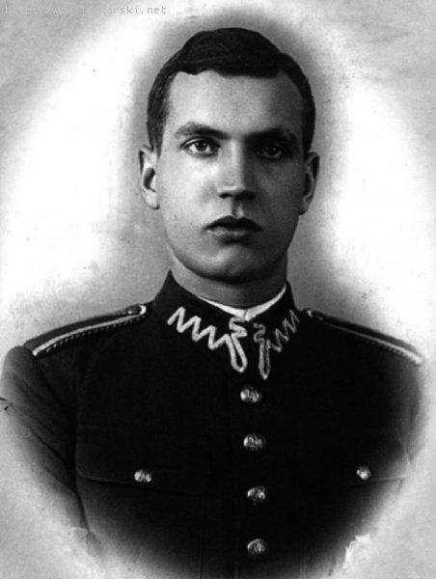
Cadete Jan Kozielewski, 1936 (Jan Karski, 1914 - 2000)
Jan Karski Educational Foundation

Slide 3
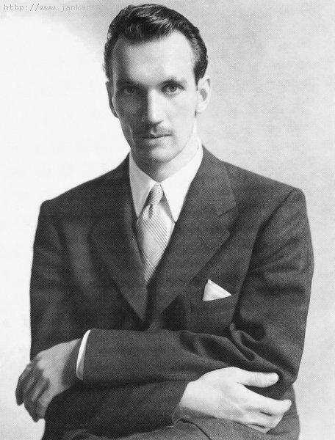
Jan Karski, 1944
Jan Karski Educational Foundation

Slide 4

Jan Karski, The Mass extermination of Jews in German Occupied Poland,
Brochura publicada em 1942 tendo como base os relatórios do Autor
Wikimedia Commons

Slide 5
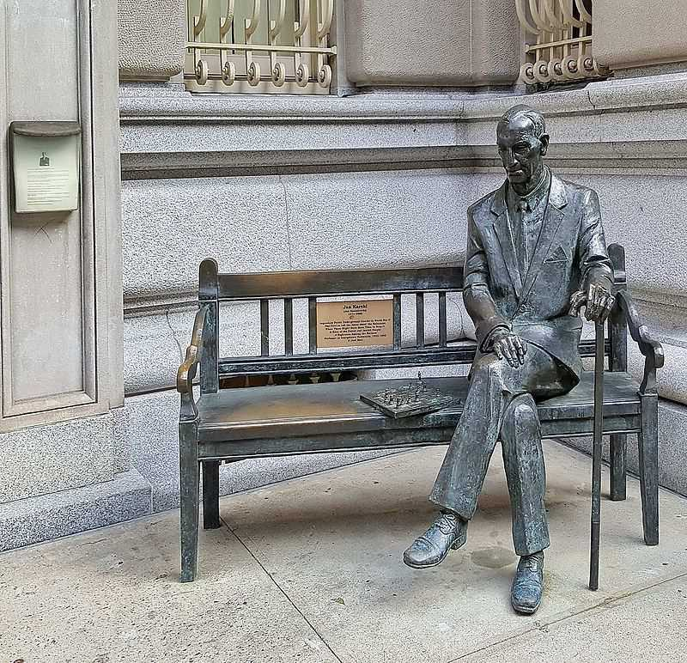
Monumento a Jan Karski em Nova Iorque (Karski bench, NY) in Jan Karski Corner
Wikimedia Commons

Slide 6
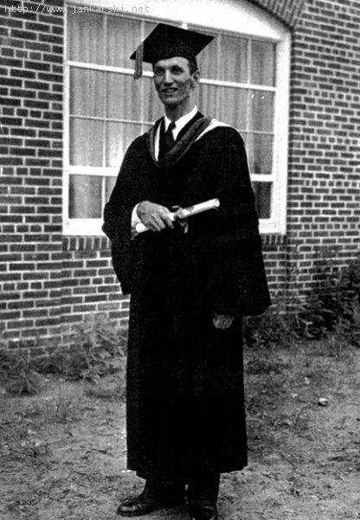
Jan Karski, 1953, Ph.D., Georgetown University
Jan Karski Educational Fund

Slide 7
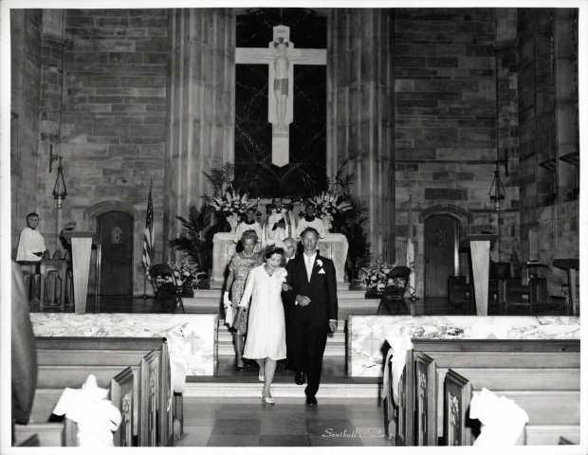
Casamento de Jan Karski e Pola Nirenska, Washington, 26.06.1965, Igreja de Sant´Ana
International Institute of Dialogue and Tradition

Slide 8

Jan Karski, The Story of a Secret State, 1944
Wikimedia Commons

Slide 9
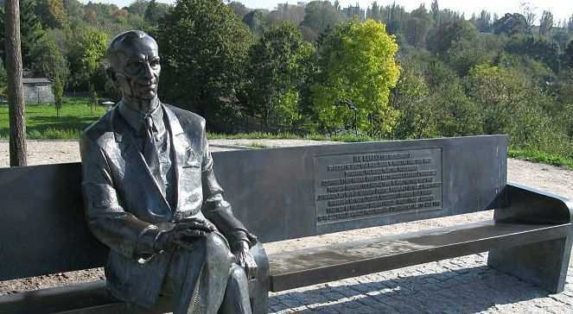
Banquinho de Jan Karski em Łódź, Polónia
Wikimedia Commons

Slide 10
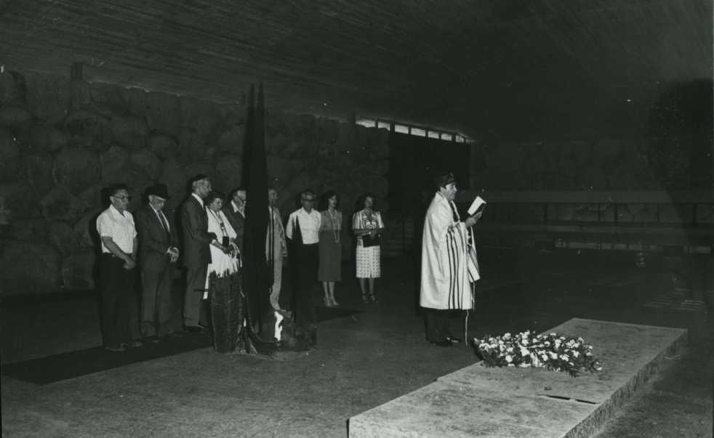
Jan Karski in Yad Vashem, 1982
The World Holocaust Remembrance Center

Slide 11
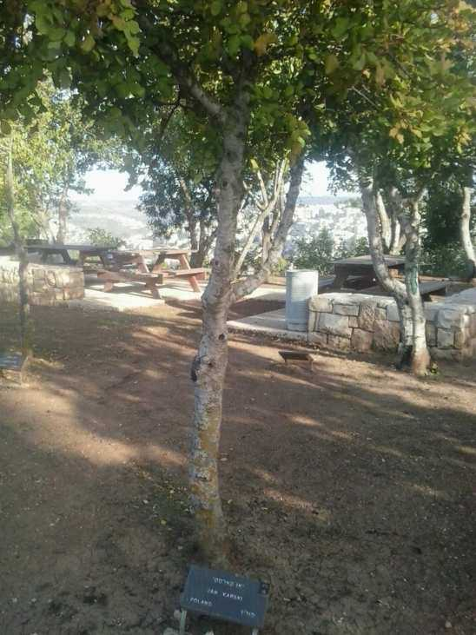
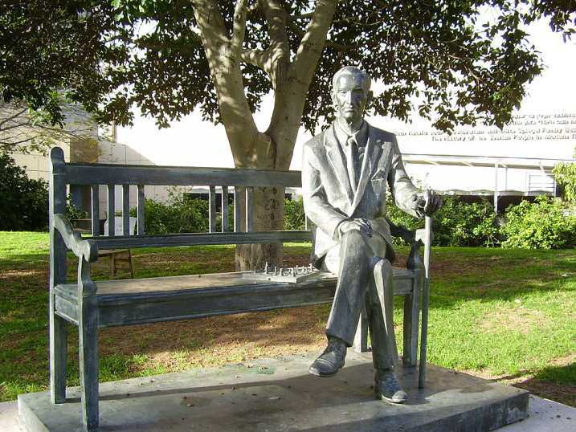
Jan Karski – o cidadão do Mundo
Estátua de Jan Karski na Universidade de Georgetown, Wikimedia Commons
Árvore de Jan Karski no Yad Vashem Institute, Wikimedia Commons

Slide 12
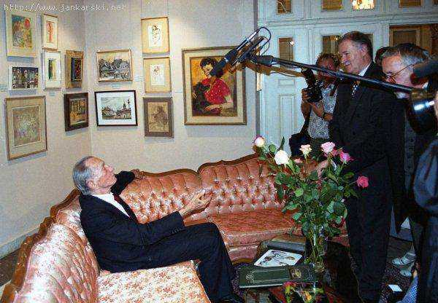
Jan Karski no seu quarto no Museu da Cidade de Łódź, 1999, Polónia
Jan Karski Educational Foundation

Slide 13
Banquinho de Jan Karski na Universidade de Telavive, Israel
Wikimedia Commons

Slide 14
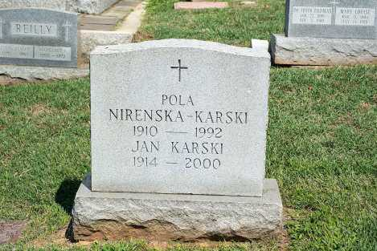
Túmulo de Jan Karski (1914 – 2000) e Pola Nirenska-Karski
Section 40, Mt. Olivet, Washington DC, USA, 2014
Wikimedia Commons

Slide 15
Karski & The Lords of Humanity
(Jan Karski i władcy ludzkości)
Poland - USA, 2015, Slawomir Grunberg film
https://www.youtube.com/watch?v=6JEdb8NQXbw
The film tells the story of Jan Karski, the Polish underground courier who traveled across occupied Europe to inform the Allied powers of Nazi crimes against the Jews of Europe in an effort to prevent the Holocaust.
Karski carried his dreadful eye-witness report to Britain and the United States, hoping that it would shake the conscience of the powerful leaders or - as he would call them - the Lords of Humanity.
www.jankarski.com
O fim (e o re-início...) do «santo dos tempos de Holocausto», Jan Kraski...

